Slide 1
Digital Electronics and Systems Lecture -2

Slide 2
Contents
Logic gates and networks.
Analysis of a logic network.
Timing diagram.

Slide 3
Logic Gates and Networks
A logic gate has one or more inputs and one output that is a function of inputs.
It is often convenient to describe a logic circuit (also known as logic network) by drawing a circuit diagram, or schematic, consisting of graphical symbols representing the logic gates.

Slide 4
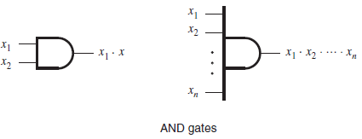
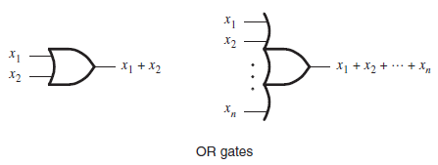


Slide 5
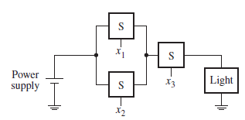

Consider the following example:
This circuit can be implemented using logic gates as follows:

Slide 6
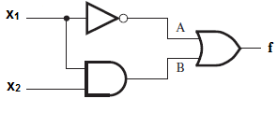
Analysis of a Logic Network
Analysis – determine the function performed by the logic network.
Consider a network that implements the function

Slide 7
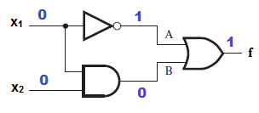
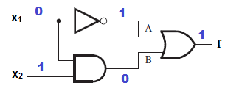
Inputs are – x₁ and x₂
Consider 4 cases:
Case 1: x₁ = 0, x₂ = 0
Case 2: x₁ = 0, x₂ = 1

Slide 8
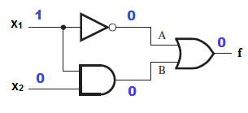
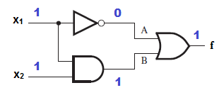
Case 3: x₁ = 1, x₂ = 0
Case 4: x₁ = 1, x₂ = 1

Slide 9
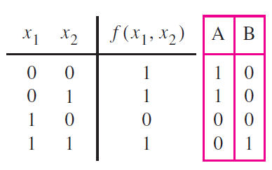
Truth table for the logic network is given as follows.

Slide 10
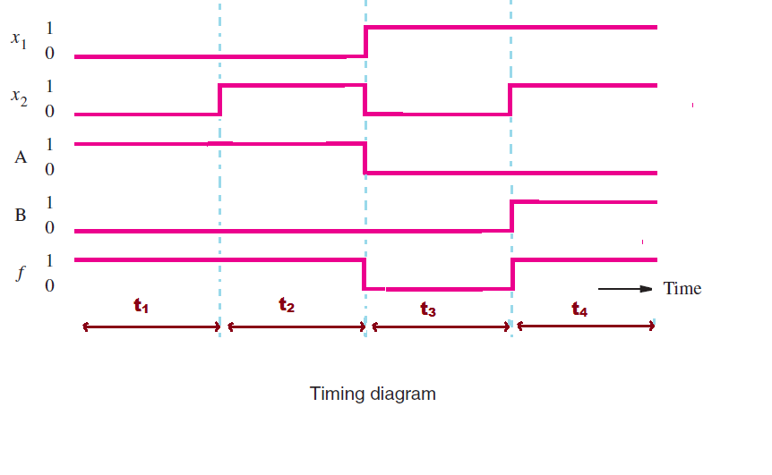
Timing diagram
The timing diagram shows that changes in the waveforms at points A and B and the output, f take place instantaneously when the inputs x₁ and x₂ change their values.

Slide 11
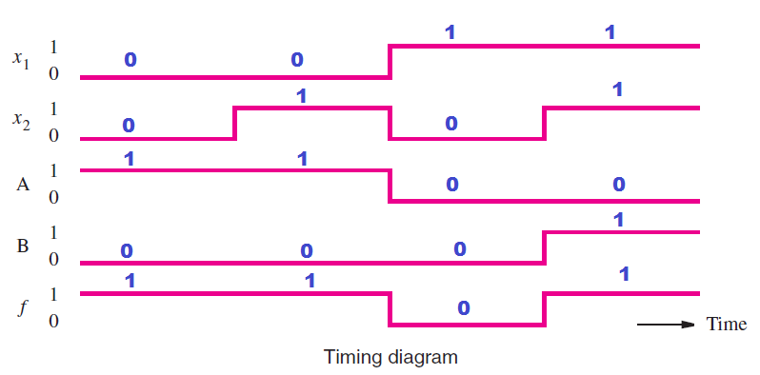

Slide 12
The above mentioned timing diagram is based on the assumption that logic gates respond to changes in their inputs in zero time.
Practical logic gates are implemented using electronic circuits which need some time to change their states. ( 1 to 0 or 0 to 1).

